Slide 1
TEMPLATE Assignment A5a Low-Fidelity Paper Prototype Examples: Project VidStream, CSC318 2020F Table of Contents 5.1 Hierarchical Task Analysis 2 5.2 Usability Testing Script 3 5.3 Low-Fidelity Paper Prototype 4 with Facilitation & Observation notes off-side, outside Slideshow

Slide 2
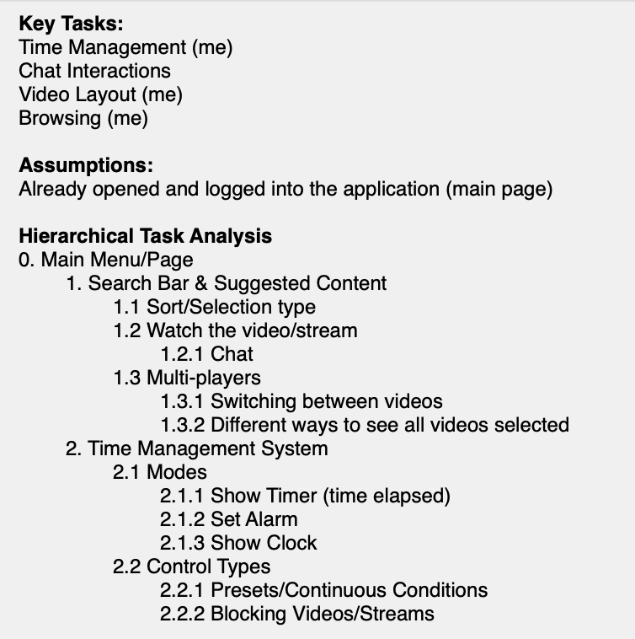
A5.1 Hierarchical Task Analysis

Slide 3
A5.2 Usability Testing Script
Scenario: You are a busy university student. You work hard but need breaks from studying. In these breaks, you struggle to keep track of time and take too long to find the right video to watch. Can you show me how you would do the following tasks using this app:
1. You open the application and want to set a 30 minute alarm so that you can get back to work for at least 90 minutes without distractions.
2. Now that the alarm is set, how can you find a video or stream to watch? Let’s choose the newest video created by your favourite creator about video games.
3. The video is too lengthy but you might want to revisit it later. Find a new video to watch without closing the previous video. How can you see which videos you have currently open?
4. You realize your sleep schedule is important so you would like to block videos/streams from playing past 12:00am until 6:00am.
Please think aloud as you interact with the paper prototype.

Slide 4
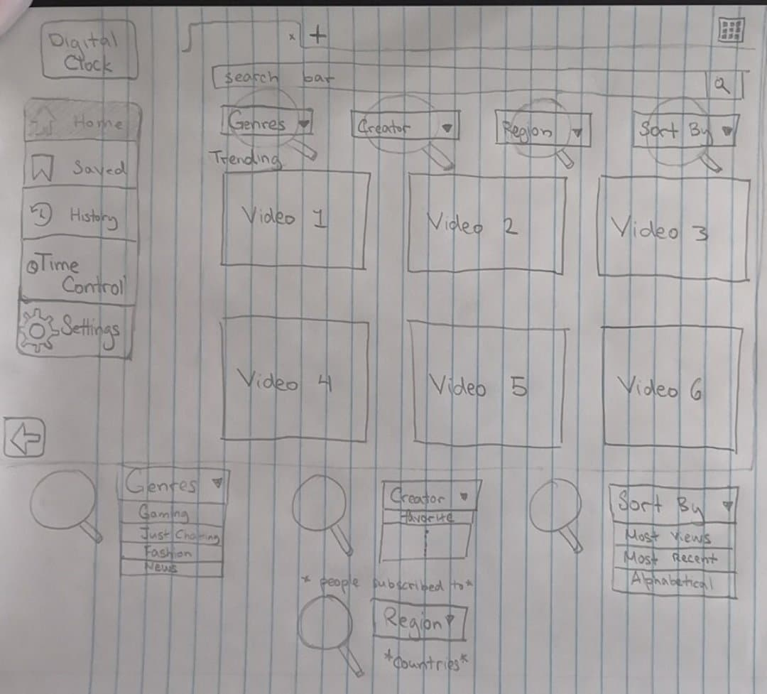
A5.3 Low-Fidelity Paper Prototype
Task 1. You open the application and want to set a 30 minute alarm so that you can get back to work for at least 90 minutes without distractions.
Note this column of text does not show during the Usability Test Slide Show; but is used for your note taking & record keeping.
Note the task instructions are repeated here to reduce participant’s memory load.
EXPECTED USER ACTION
Click [MANAGE TASKS]
OBSERVED ACTION
USER QUOTES
DESIGN IMPLICATIONS for A5b Results

Slide 5
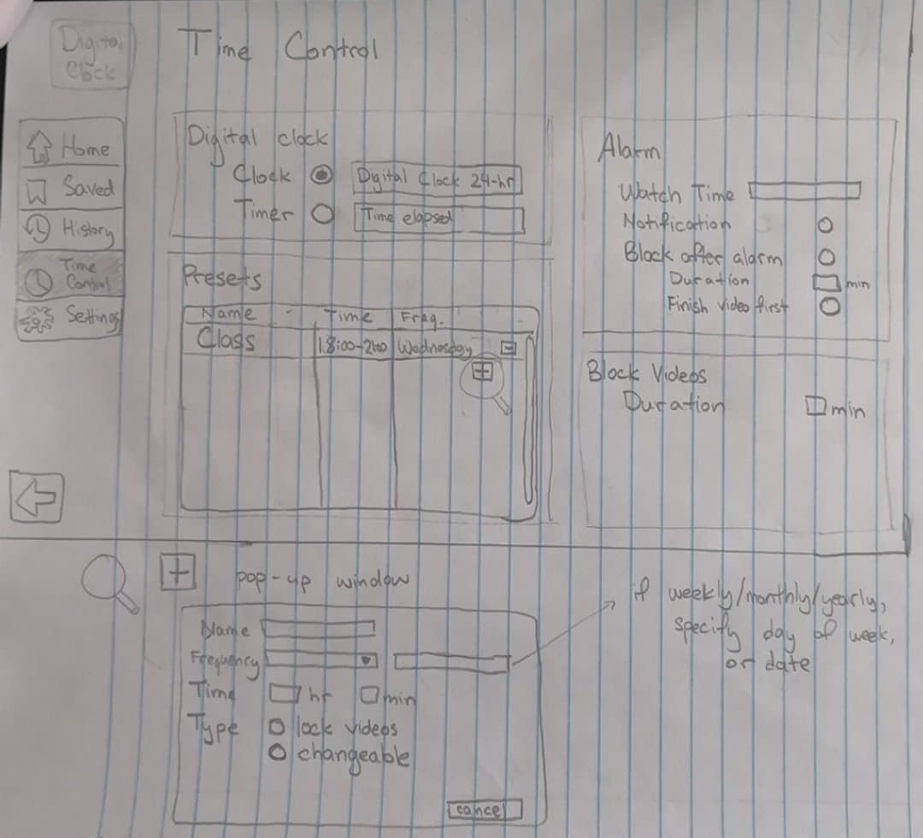

Note this column of text does not show during the Usability Test Slide Show; but is used for your note taking & record keeping.
EXPECTED USER ACTION
Click [October 16]
Click [ADD +]
OBSERVED ACTION
USER QUOTES
DESIGN IMPLICATIONS for A5b Results
Task 1. You open the application and want to set a 30 minute alarm so that you can get back to work for at least 90 minutes without distractions.
Duration

Slide 6
Note this column of text does not show during the Usability Test Slide Show; but is used for your note taking & record keeping.
EXPECTED USER ACTION
Type FROM [20:00]
Type TO [21:00]
Type LOCATION [Athletic Centre]
Check [EXERCISE]
Check [Weekly]
Check [Alarm (optional)]
Click [CHECK MARK] NOTE it’s good practice to ask users “What do you expect to happen next?”
OBSERVED ACTION
USER QUOTES
DESIGN IMPLICATIONS for A5b Results
[NEXT] button is an Action Button you can program in Powerpoint for navigation.
2. Now that the alarm is set, how can you find a video or stream to watch? Let’s choose the newest video created by your favourite creator about video games.

Slide 7
2. Now that the alarm is set, how can you find a video or stream to watch? Let’s choose the newest video created by your favourite creator about video games.
Alarm

Slide 8
2. Now that the alarm is set, how can you find a video or stream to watch? Let’s choose the newest video created by your favourite creator about video games.
Alarm
Gaming
Favourite
Newest

Slide 9
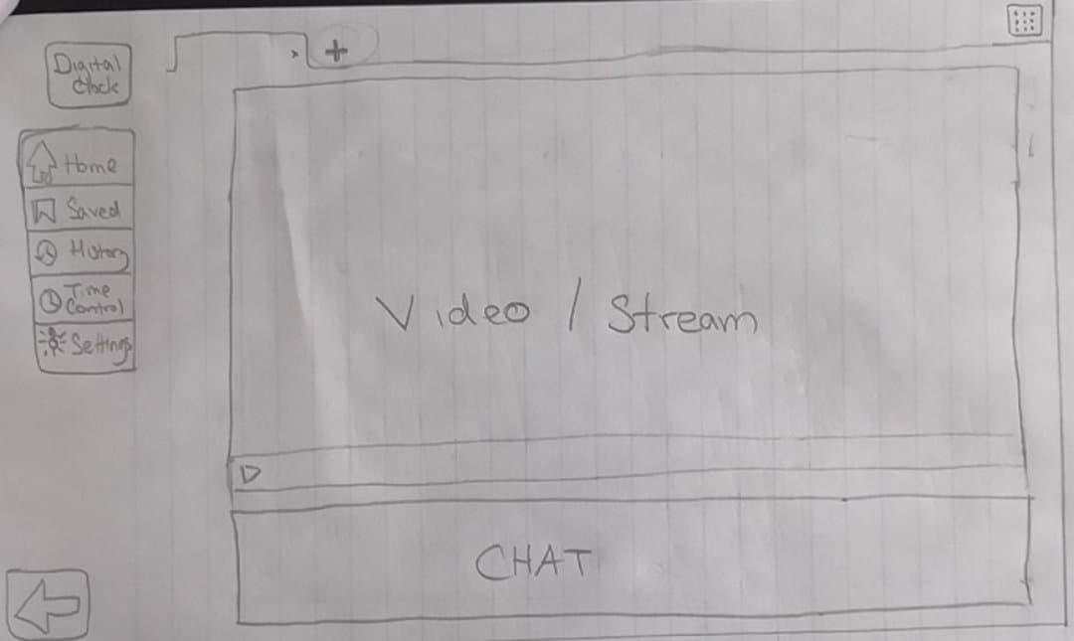
2. Now that the alarm is set, how can you find a video or stream to watch? Let’s choose the newest video created by your favourite creator about video games.

Slide 10
3. The video is too lengthy but you might want to revisit it later. Find a new video to watch without closing the previous video. How can you see which videos you have currently open?

Slide 11

3. The video is too lengthy but you might want to revisit it later. Find any new video to watch without closing the previous video. How can you see which videos you have currently open?
Video 1

Slide 12
3. The video is too lengthy but you might want to revisit it later. Find any new video to watch without closing the previous video. How can you see which videos you have currently open?
Video 1
Video 2

Slide 13
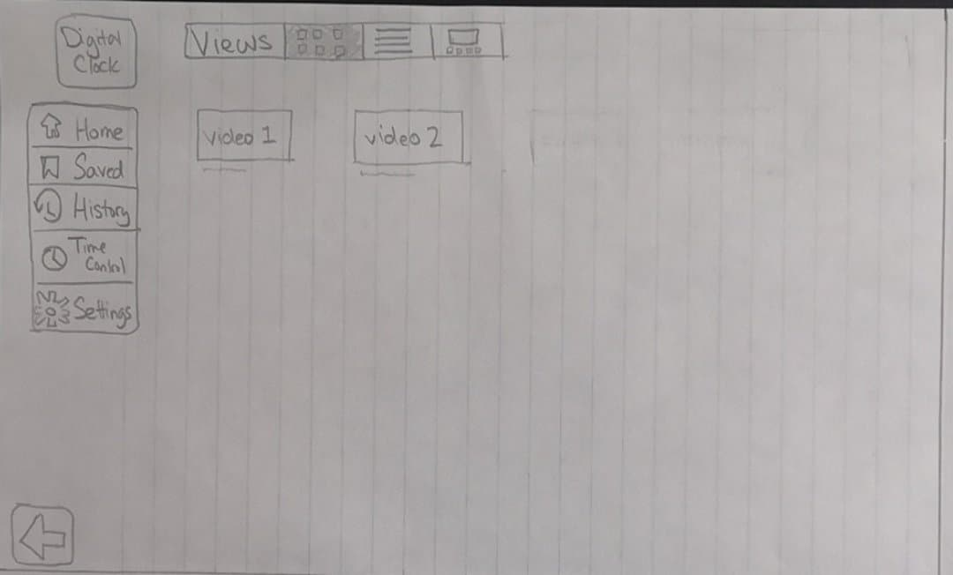
3. The video is too lengthy but you might want to revisit it later. Find any new video to watch without closing the previous video. How can you see which videos you have currently open?

Slide 14
4. You realize your sleep schedule is important so you would like to block videos/streams from playing past 12:00am until 6:00am.

Slide 15
Note this column of text does not show during the Usability Test Slide Show; but is used for your note taking & record keeping.
EXPECTED USER ACTION
Click [October 16]
Click [ADD +]
OBSERVED ACTION
USER QUOTES
DESIGN IMPLICATIONS for A5b Results
4. You realize your sleep schedule is important so you would like to block videos/streams from playing past 12:00am until 6:00am.

Slide 16
Note this column of text does not show during the Usability Test Slide Show; but is used for your note taking & record keeping.
EXPECTED USER ACTION
Click [October 16]
Click [ADD +]
OBSERVED ACTION
USER QUOTES
DESIGN IMPLICATIONS for A5b Results
4. You realize your sleep schedule is important so you would like to block videos/streams from playing past 12:00am until 6:00am.
Sleep
Daily
12
00
Duration
6
00

